Slide 1
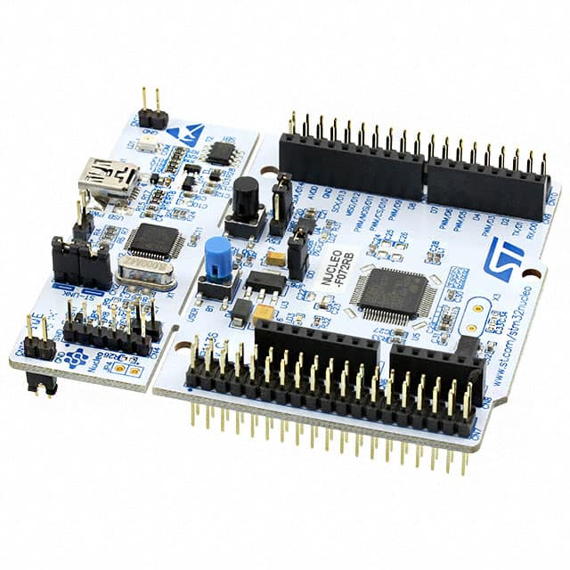
1、Desktop/Server:
x86/AMD64: Windows / Linux
multi processors/sockets
2、Embedded:
2.1 MPU: multi cores, Linux
Processor
2.2 MCU: single core, RTOS
Controller
Real Time Operating System
note: SOC - System On Chip
Adaptor:
power & communication
ST-Link
SWD – Serial Wire Debug
Notes:
2020-09-19

Slide 2
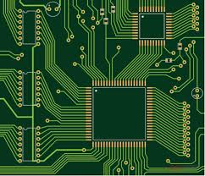
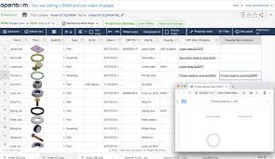
PCB - Printed Circuit Board
BOM – Bill Of Materials
Components to Order

Slide 3
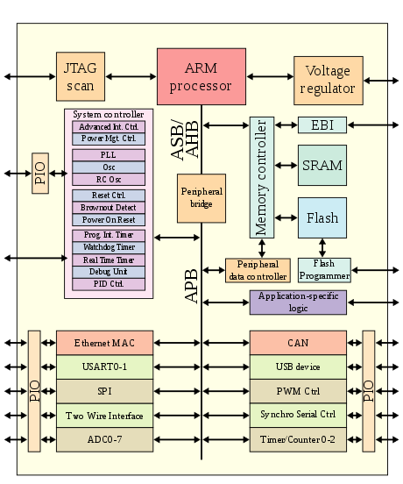
ARM architecture
CPU
Memory
IO
SOC - System On Chip
Hardware
Software
(Bootloader)

Slide 5
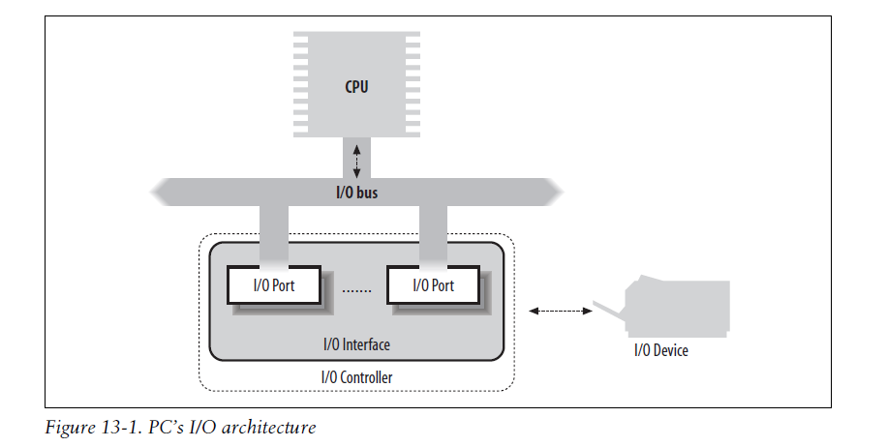

Slide 6
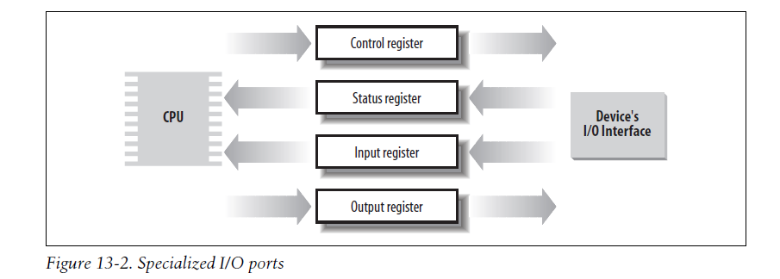
I/O Interfaces ports/registers/io mapped memory locations 计算机CPU端的
Interrupt vs Polling
Case by Case
Standard

Slide 7
Schematics 电路原理图
MCU
SOC
MCU
SOC
USB
Power
SWD/ST-Link/DEBUG
UART/COM4

Slide 8
Schematics 电路原理图

Slide 10
GND
3V3

Slide 11
Driver:
The Cortex microcontroller software interface standard (CMSIS)
HAL -- Hardware Abstraction Layer
LL -- Low-Layer drivers
C Programming

Slide 12
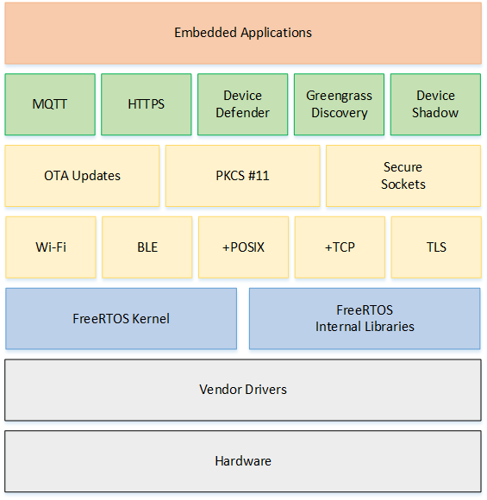
FreeRTOS
No Segmentation
No Paging
No Multi-user
No Terminal
Host/IDE

Slide 13
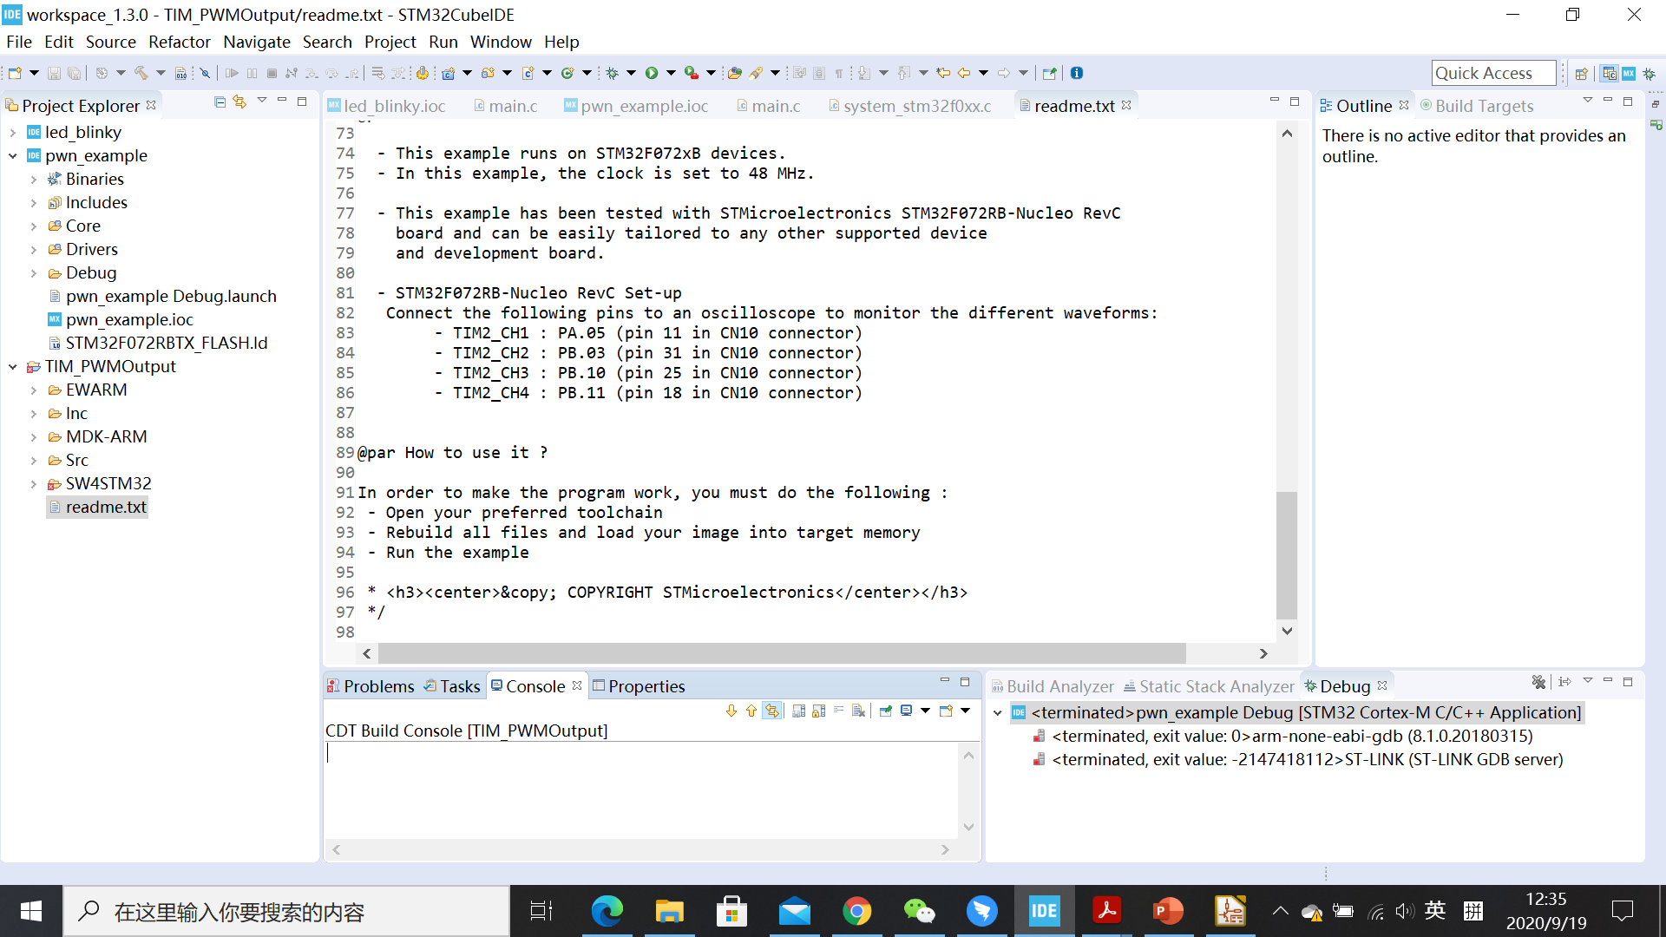
STM32CubeIDE

Slide 14
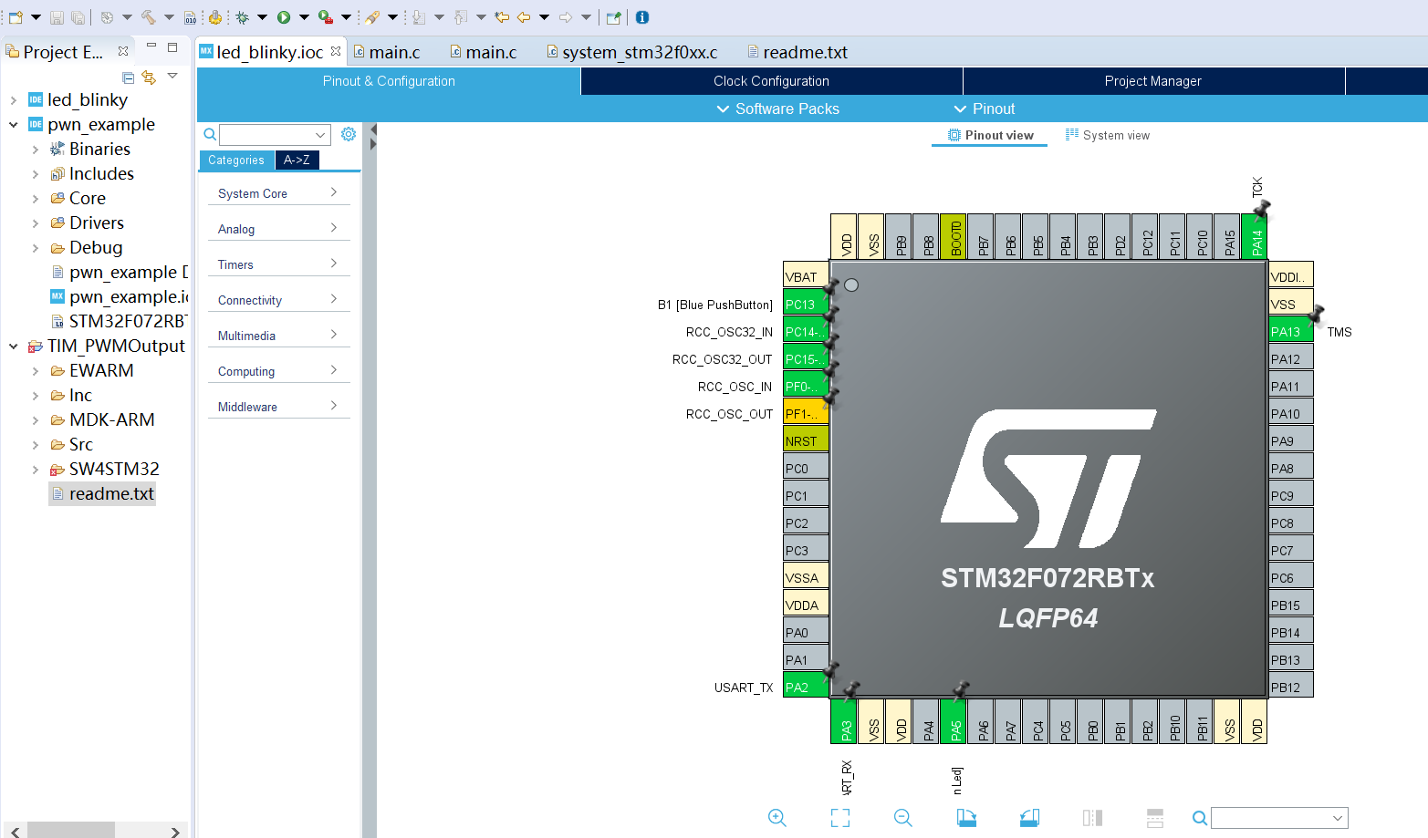

Slide 15
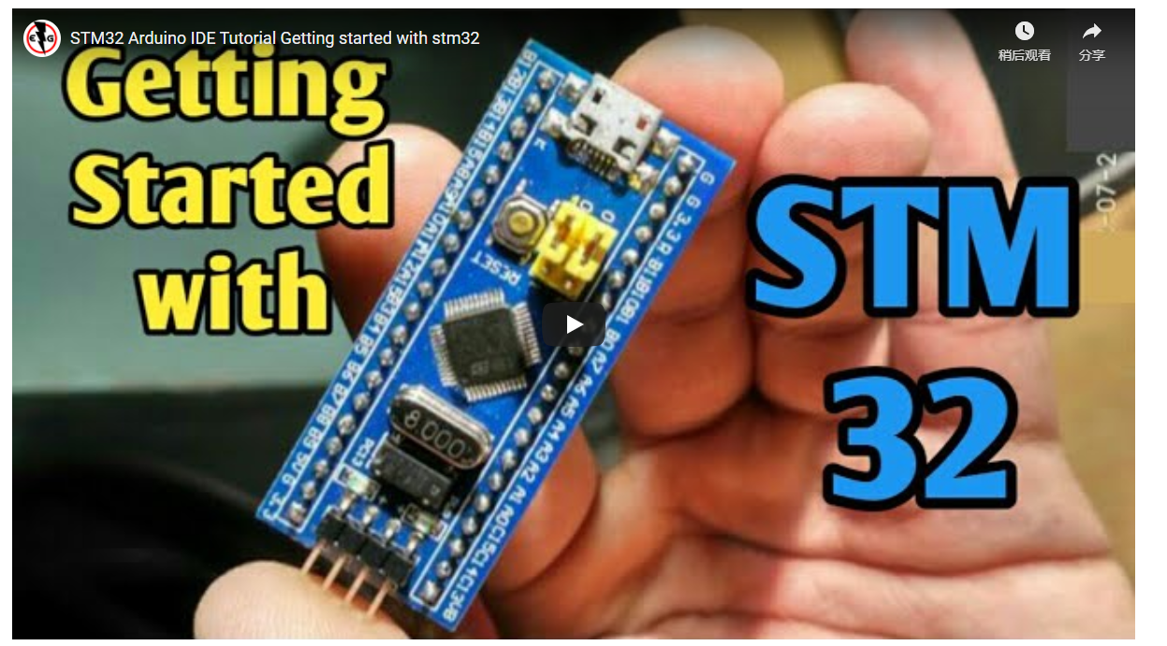
Using Arduino IDE

Slide 16
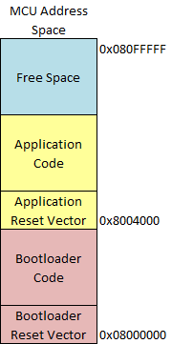
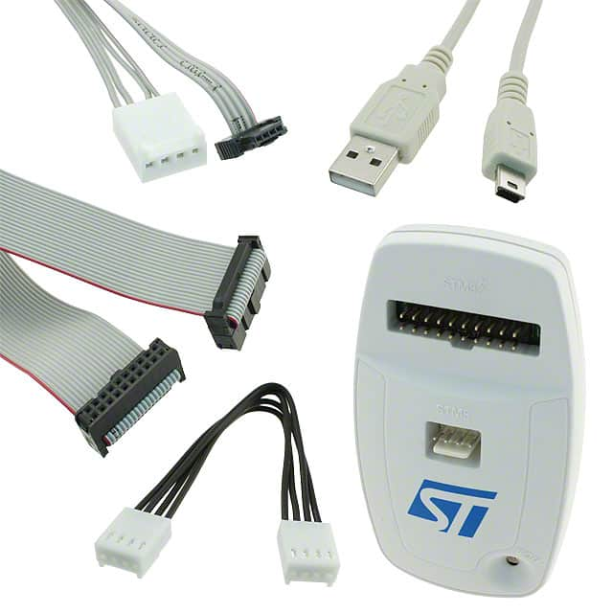
ST-LINK/V2 - SWD/JTAG
Bootloader

Slide 17
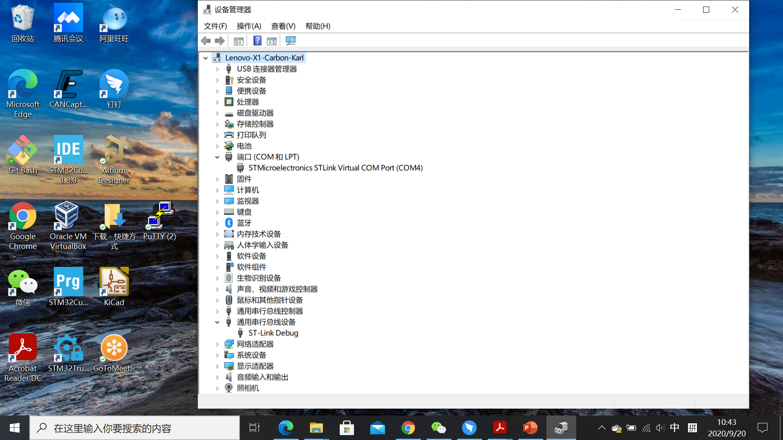
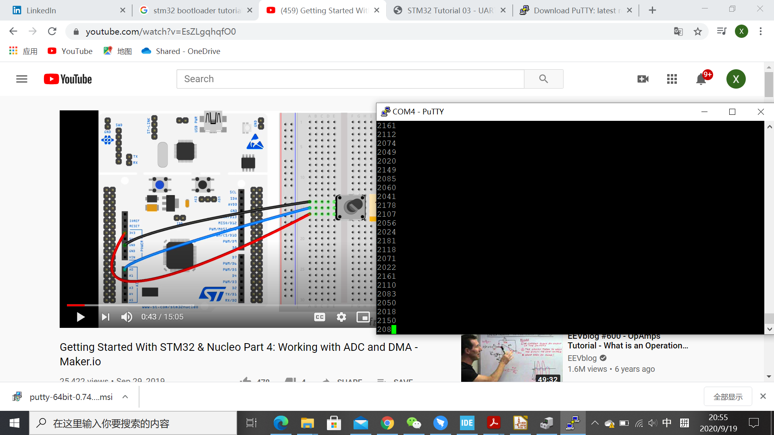

Slide 18
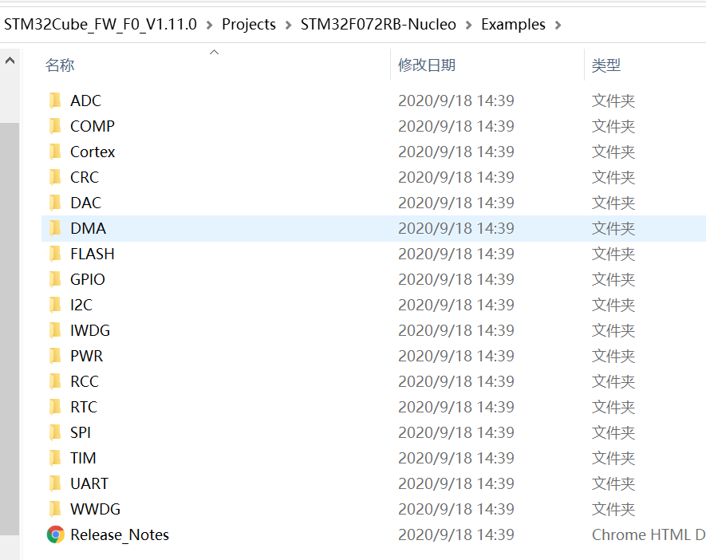
SDK – Software Development Kit

